Slide 1
LED BLINKING USING ARDUINO UNO
BY-
IFTEKAR ANSARI-B345
SUNIL GAIKAWAD-B346
ABHAY PAROCHA -B352
SHIVAM YADAV- B355

Slide 2
ABSTRACT
Blinking LED is one of the important projects in alerting someone to indicate the presence of object. But in normal circuit it is difficult to adjust time of turning on and turning of time. Which ultimately lower the chances visibility. But with the help of arduino we can control the timing of light on and off according to our need.

Slide 3
INTRODUCTION
This project demonstrates how we have implemented blinking LED using Arduino. Pin modes configuration is used to indicate the pin of the arduino which we are using. We can set whatever time of on and off of the LED as per the requirement and with that single pin of the arduino we can connect as much LED as we want.

Slide 4
COMPONENTS
ARDUINO UNO
RESISTOR -1k
LED
ARDUINO IDLE SOFTWARE

Slide 5
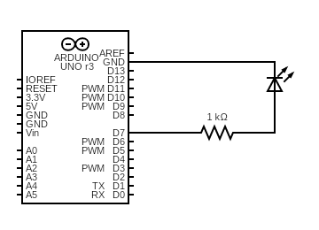
CIRCUIT DIAGRRAM

Slide 6
WORKING
To blink LED means to turn OFF and ON.
Send commands to turn LED ON and OFF to port 7 as output.
Resistor is connected to port 7 and other end to LED
LED's one end is connected to ground

Slide 7
CODE
void setup() {
pinMode(7, OUTPUT);}
void loop() {
digitalWrite(7,HIGH);
delay(3000);
digitalWrite(7,LOW);
delay(2000);}

Slide 8
CONCLUSION
In this project we have implemented Blinking LED using Arduino in which we have used arduino software and came across many things like the delay must be in millis sec and the burning of program with this offline software.

Slide 9
THANKYOU

